Slide 1

Exploring Size-Speed Trade-Offs in Static Index Pruning
Juan Rodriguez Torsten Suel Tandon School of Engineering
New York University Brooklyn, NY
Supported by NSF Grant IIS-1718680 and by Amazon.
Juan Rodriguez
IEEE Big Data 2018 - Seattle, WA

Slide 2
Presentation and code available at:
https://github.com/JC-R/BD2018

Slide 3
Introduction
Inverted Index: structure used in search engines
For each word, we store where it is used
Inverted list for term t contains index entries (postings)
Postings have form (did, f) where did is the ID of a
document containing t and f is the number of occ.

Slide 4
Introduction
Inverted Index
term
posting (inverted) list
posting

Slide 5
Problem Definition
+
Query processing in a nutshell:
Traverse inverted lists for query terms
Apply a ranking function to docs in union or intersection
E.g., cosine, BM25, or more complex ranker
Then return the top-k results to the user

Slide 6
Problem Definition
Many inverted lists are very long
We cannot afford to traverse and rank complete lists
Search engines use shortcuts: “early termination techniques”: - Index tiering, impact ordering, maxscore/wand etc. - Index pruning is one early termination (ET) techn.
Notes:
Query processing performance challenge:

Slide 7
Index Pruning
“would anybody search for doc 454 using this term?”
“will this posting ever lead to a top-k result for a likely query?”
If “no”, remove this posting from the index

Slide 8
Motivation – Index Pruning
Goal: Remove postings that are (fairly) useless, while keeping quality “almost” the same
Why? Shorter lists lead to faster query processing
Smaller indexes: need less RAM or disk accesses
Smaller indexes: search on devices at the edge
Index pruning is a non-safe ET technique (lossy)
Notes:
Performance: shorter lists: less traversal
→ results after pruning are not exactly the same

Slide 9
Index Pruning
Motivation
Suppose a search engine indexes 4 trillion documents
250 index entries per document → 10^15 entries
5B queries per day, with 3.4 terms on average
< 170 billion index entries lead to top-10 in a month
Actually, far less ...
Can we find and remove them from the index?

Slide 10
Static Index Pruning
Related Work
Introduced by Carmel et al (SIGIR 2001)
A lot of subsequent work
Three main approaches:
Algorithmic heuristics: based on impact, rank
Hit-based methods: based on past top results
Curation-based: build a high-quality subset
Not the same as spam detection/removal
Notes:
Algorithmic Heuristics:
Keep postings with impact score above threshold
In each list, keep the top x%, or the top x
Many combinations of these
Hit-based methods:
Use past query results to decide what to keep
Posting-based or document-based
Posting-based: we need a lot of queries
One solution: combine with heuristics (UP-QV, TCP-QV)

Slide 11
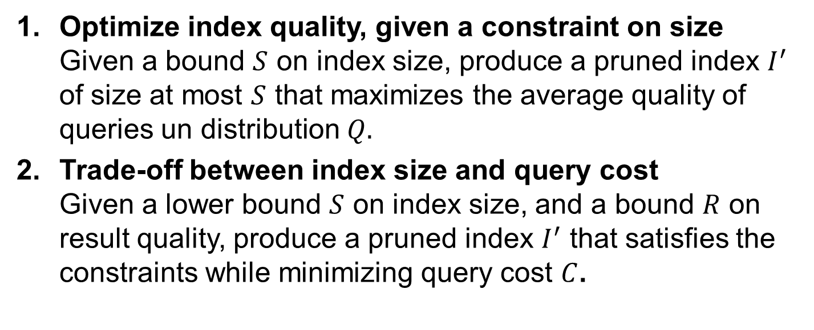
Static Index Pruning
Our Work
Optimize index quality, given a constraint on size Given a bound $S$ on index size, produce a pruned index $I^{′}$ of size at most $S$ that maximizes the average quality of queries un distribution $Q.$
Trade-off between index size and query cost Given a lower bound $S$ on index size, and a bound $R$ on result quality, produce a pruned index $I^{′}$ that satisfies the constraints while minimizing query cost $C$.

Slide 12
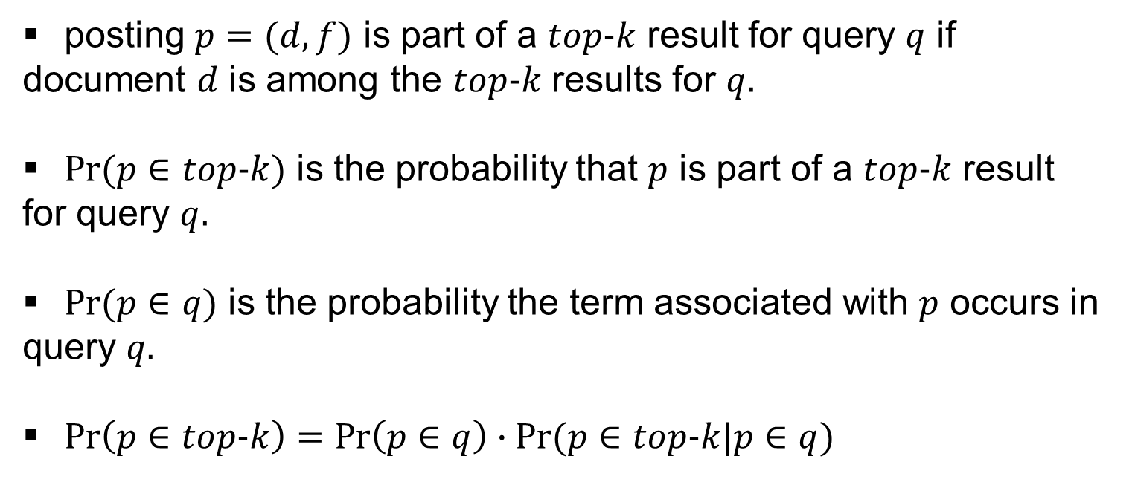
Static Index Pruning
posting $p=(d,f)$ is part of a $top-k$ result for query $q$ if document $d$ is among the $top-k$ results for $q.$
$Pr⁡(p∈top-k)$ is the probability that $p$ is part of a $top-k$ result for query $q.$
$Pr⁡(p∈q)$ is the probability the term associated with $p$ occurs in query $q.$
$\operatorname{Pr}\left(p∈top-k\right)=\operatorname{Pr}\left(p∈q\right)∙Pr⁡(p∈top-k|p∈q)$

Slide 13
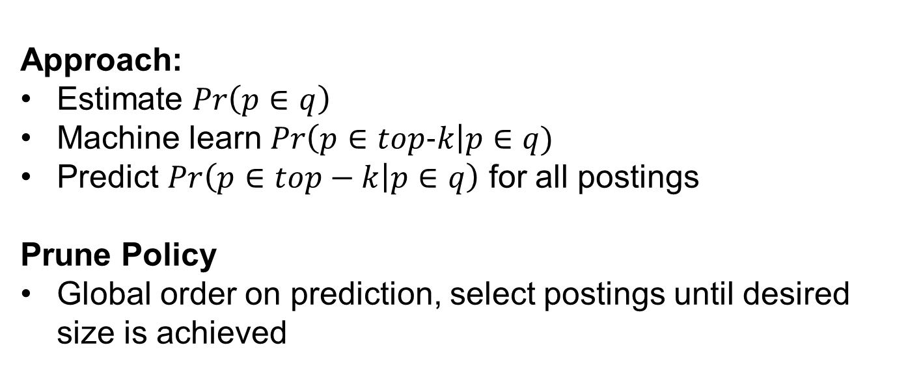
Static Index Pruning
1. Optimize index quality, given a constraint on size
Approach:
Estimate $Pr\left(p∈q\right)$
Machine learn $Pr\left(p∈top-k\right|p∈q)$
Predict $Pr\left(p∈top−k | p∈q\right)$ for all postings
Prune Policy
Global order on prediction, select postings until desired size is achieved

Slide 14
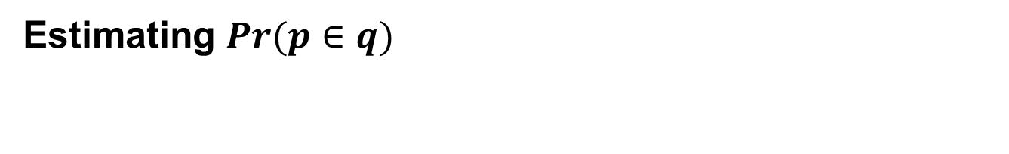
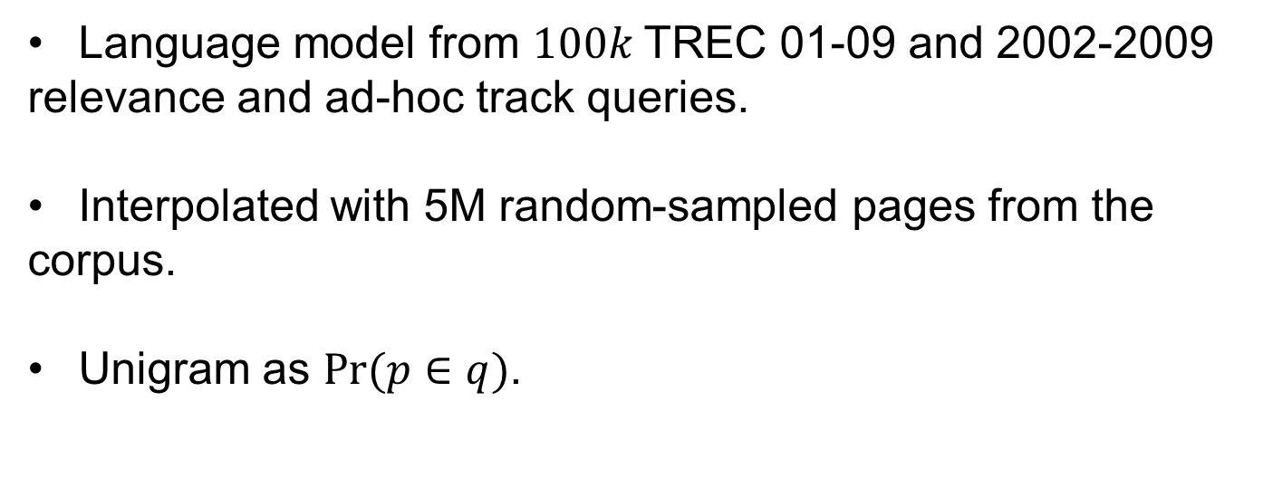
Estimating $Pr⁡(p∈q)$
Language model from $100k$TREC 01-09 and 2002-2009 relevance and ad-hoc track queries.
Interpolated with 5M random-sampled pages from the corpus.
Unigram as $Pr⁡(p∈q)$.

Slide 15
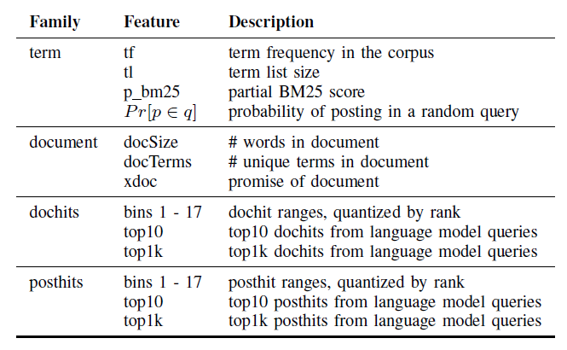
Random Forest
Training size: 1M
Predict on entire index 16 billion postings
Spark cluster on Hadoop
1024 Vcores
3Tb RAM
200 Tb HD

Slide 16
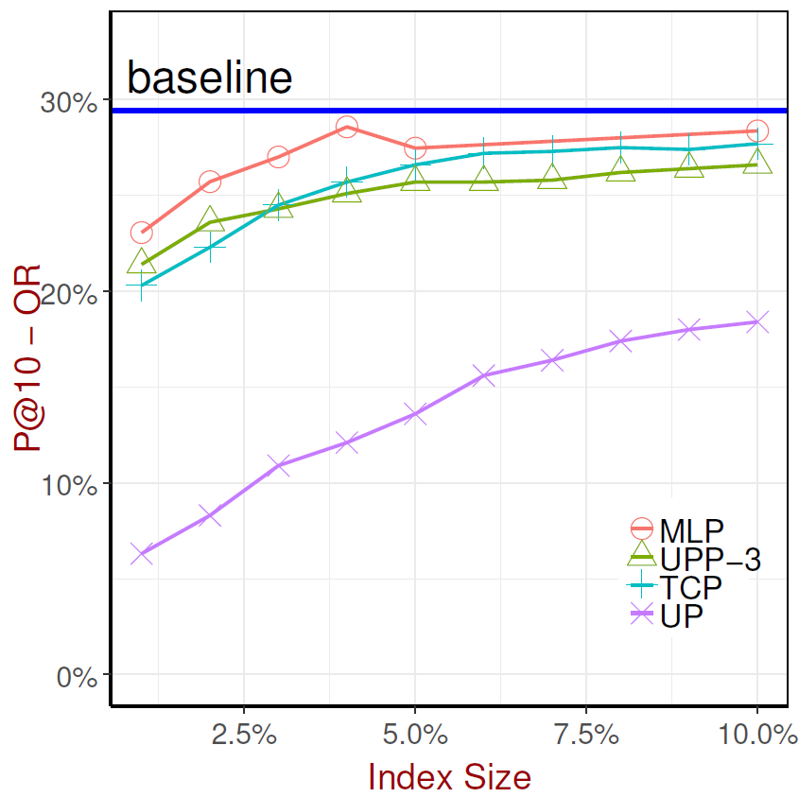
Experimental Results
Machine Learned Pruning
Very high pruning ratios
Quality metrics P@10 Postings Kept* Results Kept*
Notes:
We do not know how to optimize for RK, PK

Slide 17
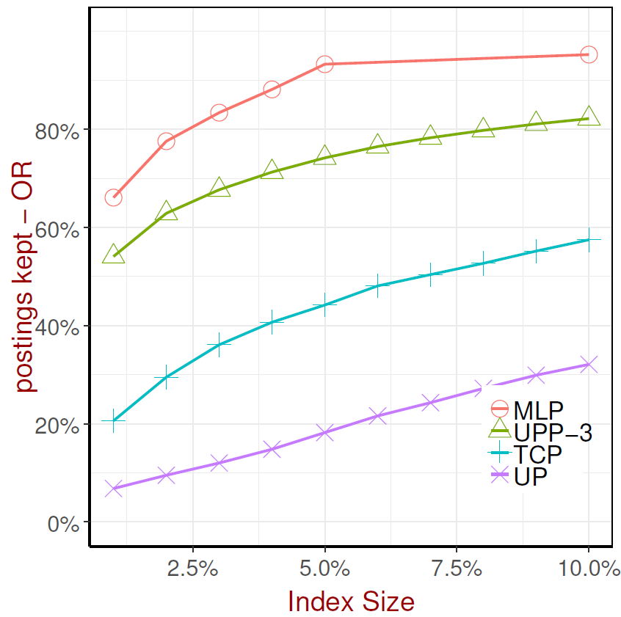
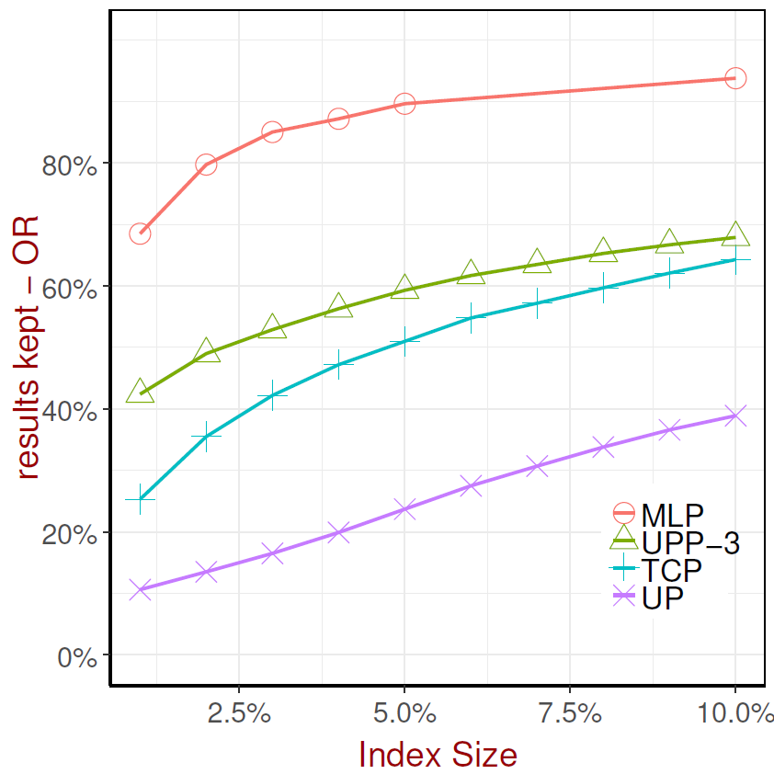
Notes:
PK, RK – may improve results under a complex ranker scenario

Slide 18
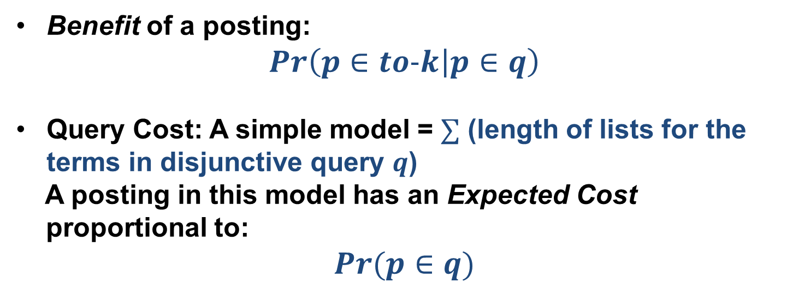
2. Trading-Off between Index Size and Query Cost

Slide 19
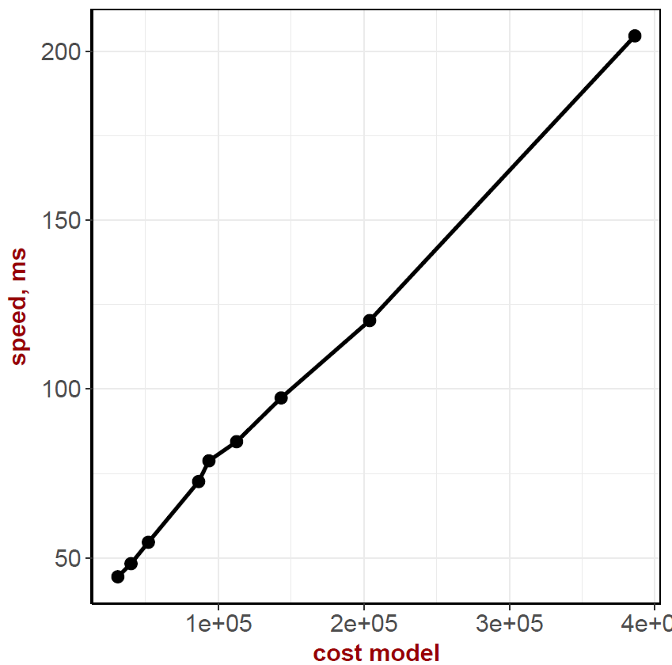
Cost Model Validation
Actual query speed measurements show near linear relationship to our cost model!

Slide 20
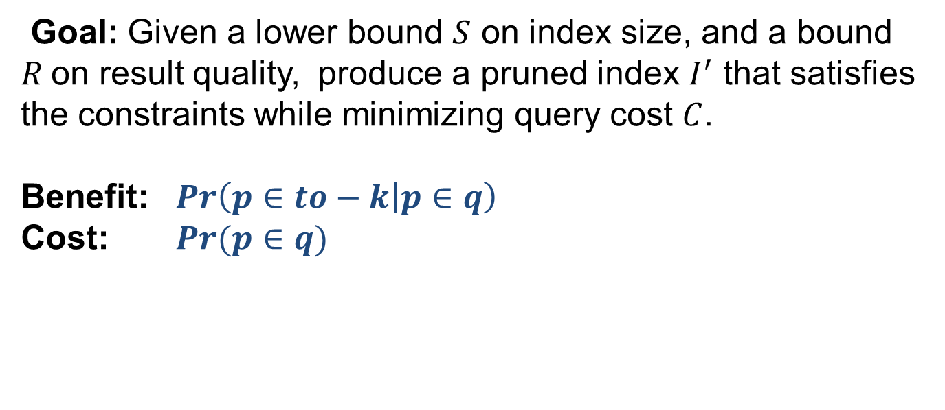
Size Cost Trade-Off

Slide 21
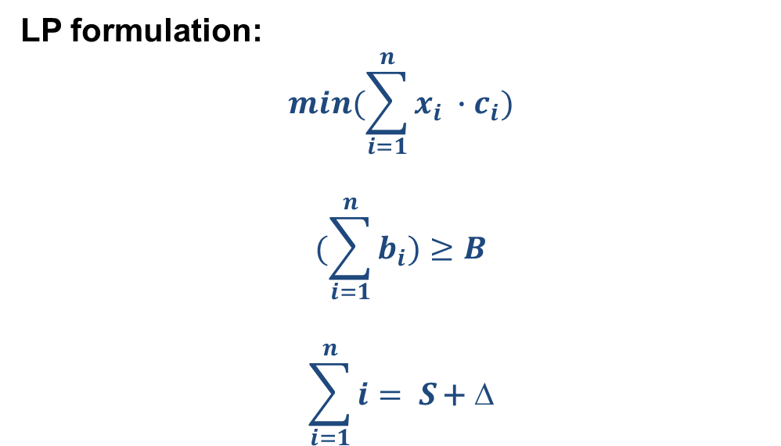
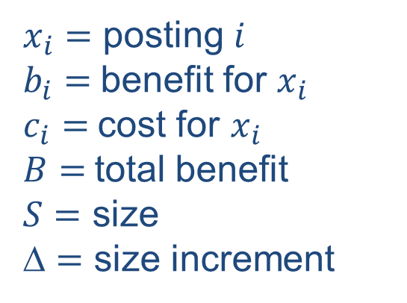
Size Cost Trade-Off
Notes:
This is a linear programming formulation

Slide 22
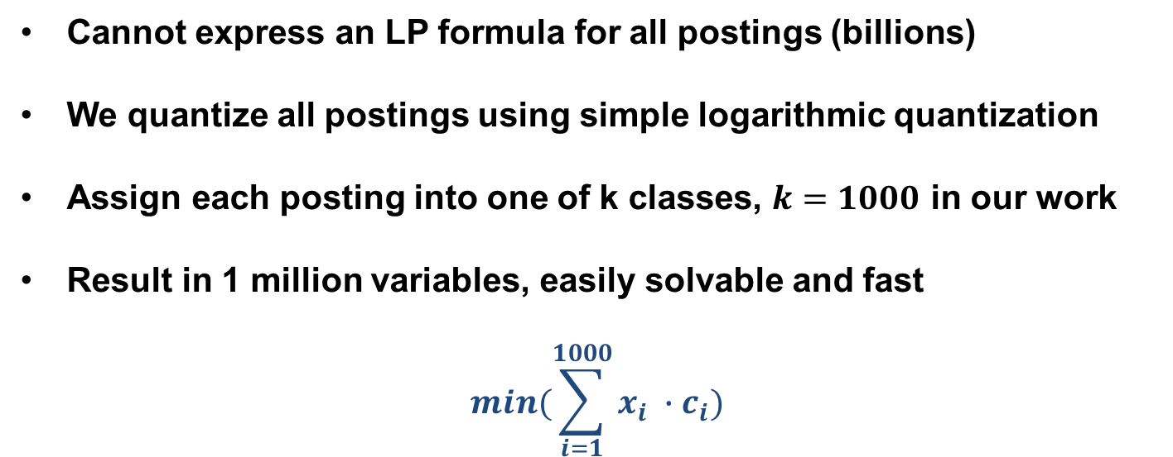
Size Cost Trade-Off

Slide 23
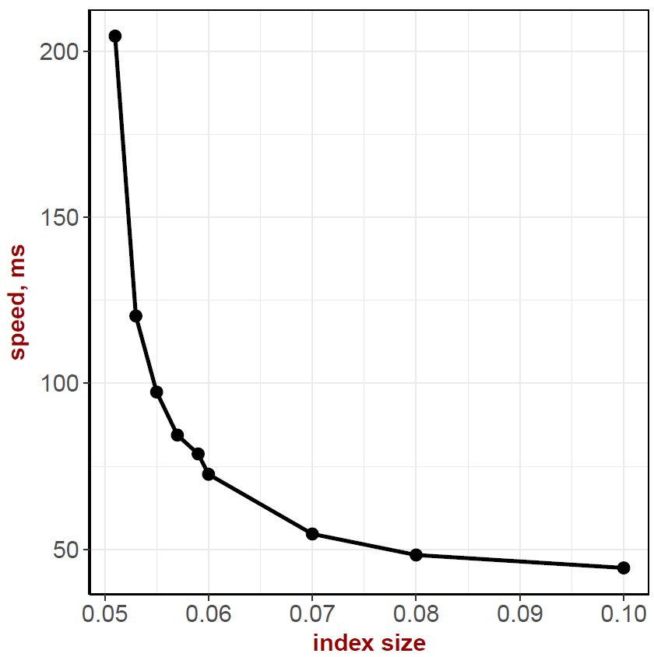
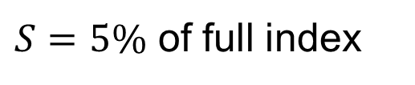
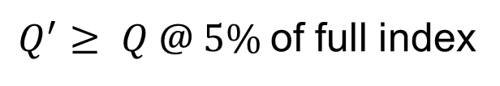
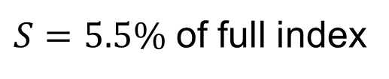
Size Cost Trade-Off
Results
$S=5\%$ of full index
$S=5.5\%$ of full index
$Q^{′}≥ Q @ 5\%$of full index

Slide 24
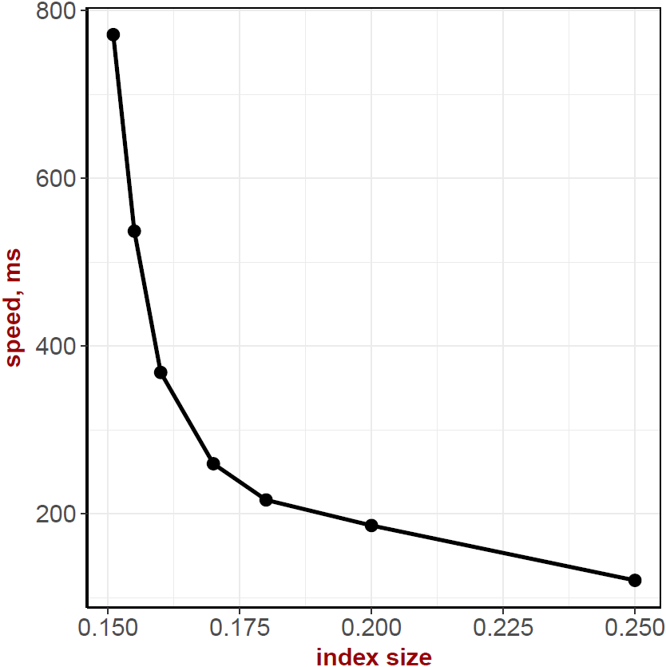
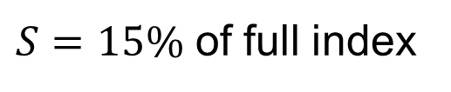
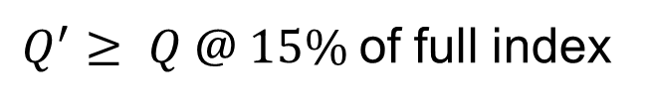
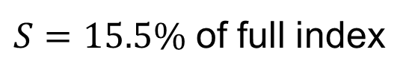
Size Cost Trade-Off
Results
$S=15\%$ of full index
$S=15.5\%$ of full index
$Q^{′}≥ Q @ 15\%$of full index

Slide 25
Summary
1. Learning to prune: optimize for size.
2. Can significantly increase query processing speed if we allow a very small increment in index size
1 + 2 = optimal size/cost at any index pruning size

Slide 26
Open Questions
We learned to optimize size for a simple ranking function, BM25.
Need to explore learning to prune under complex ranking functions

Slide 27
Thanks for listening!
Questions?

